Slide 1
Active Aging & Falls Prevention
Mairéad Power
Chartered Physiotherapist

Slide 2
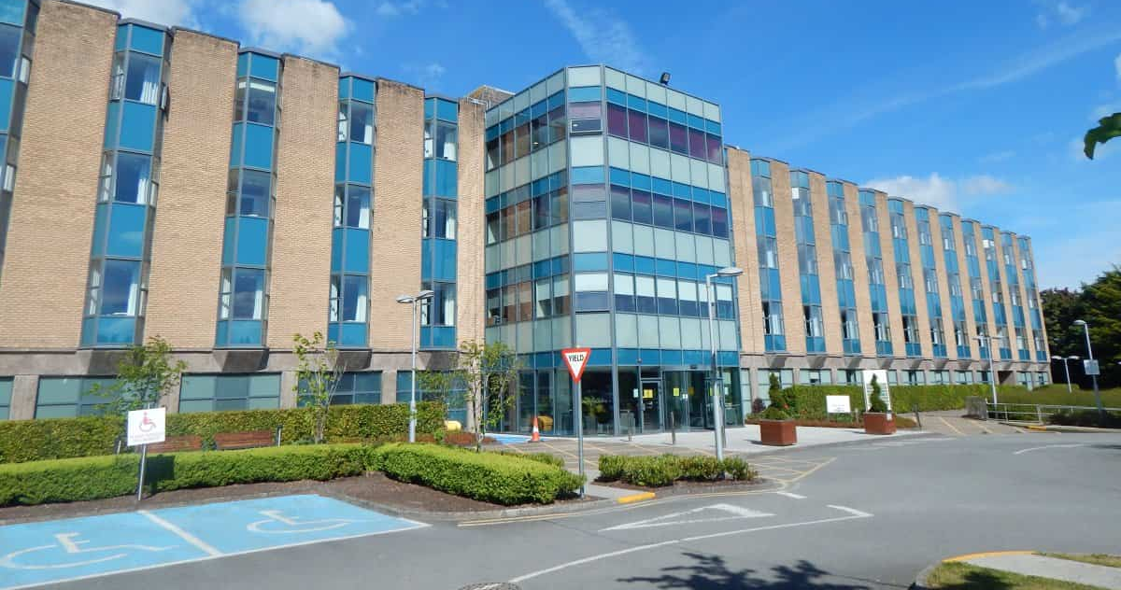

Slide 3
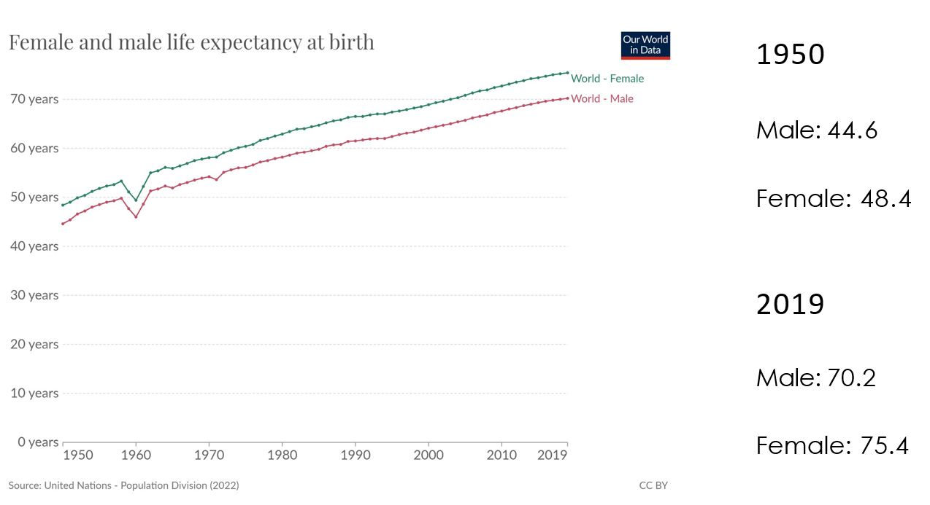
Today we can expect to live 32 years longer than the average person in 1950 !
Notes:
Trend for live expectancy continues to increase
1950 is 73 years ago

Slide 4
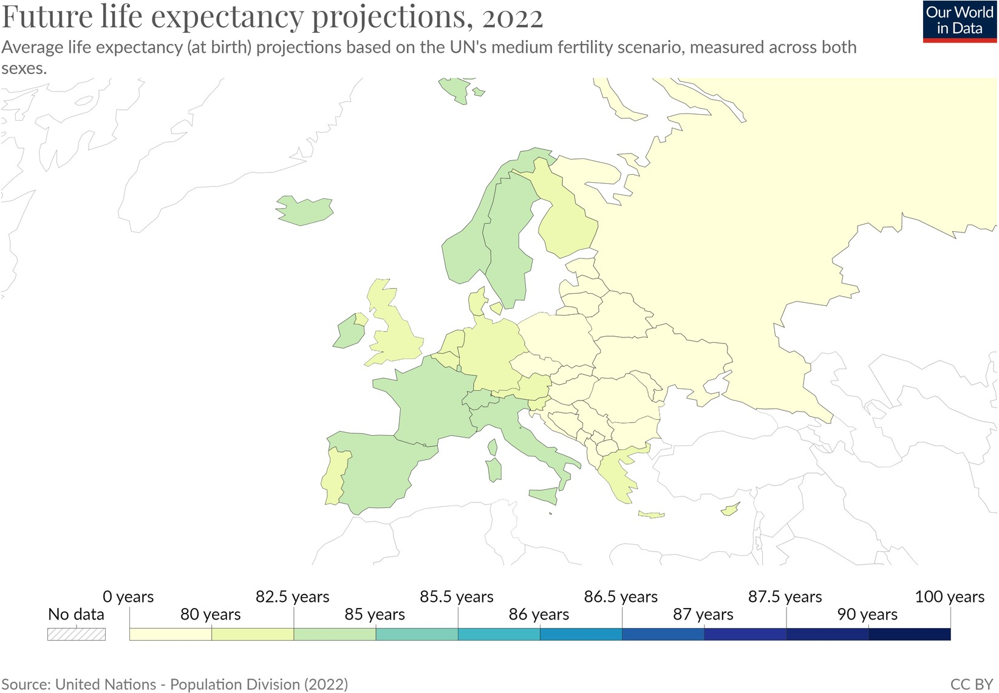
Life Expectancy
in Ireland (2022)
82.81 Years

Slide 5
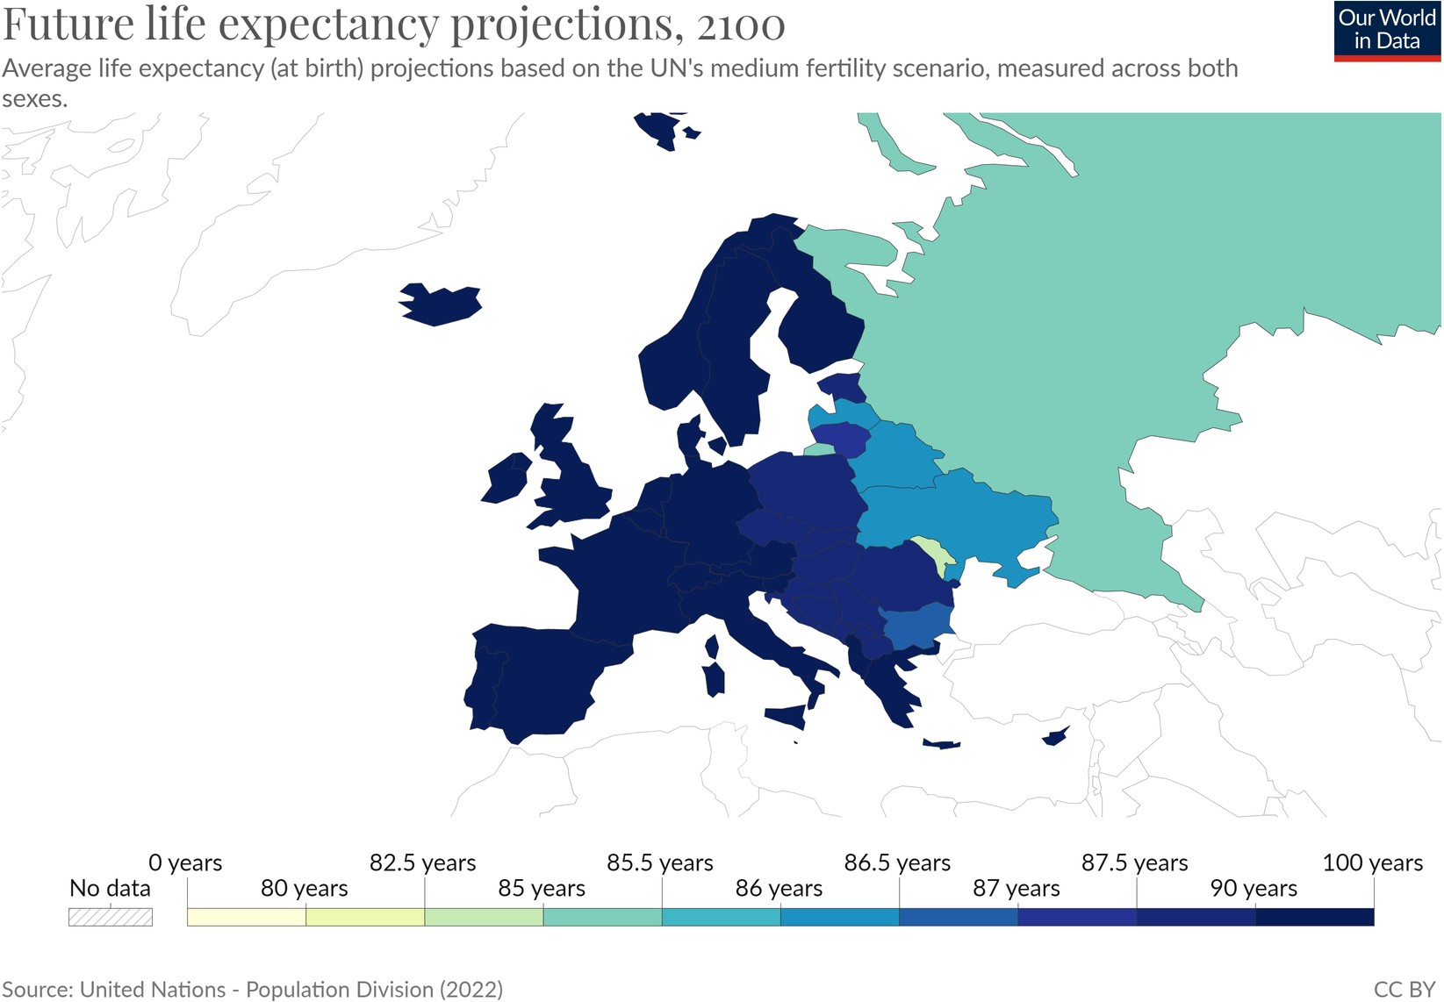
Life Expectancy
in Ireland (2100)
92.3 Years
Notes:
In 77 years it will be 2100
So 70 odd years ago its was 1950 and we expected to live until our 40’s
And in another 70 odd years we will live into our 90’s!

Slide 6
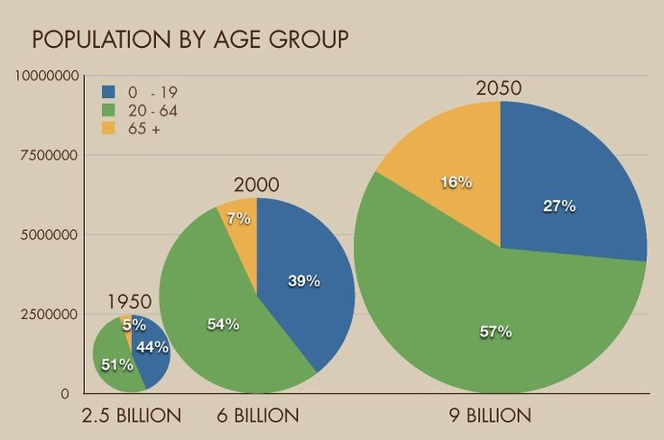
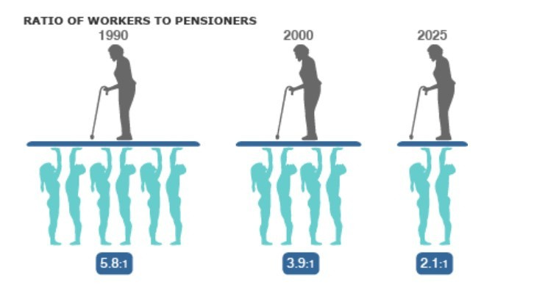
Unsustainable System
Notes:
People worldwide are living longer. Every country in the world is experiencing growth in both the size and the proportion of older persons in the population.
Between 2015 and 2050 the proportion of the world's population over 60 years will nearly double from 12% to 22%.
The number of people aged 80 years or older is expected to triple between 2020 and 2050 to reach 426 million.

Slide 7
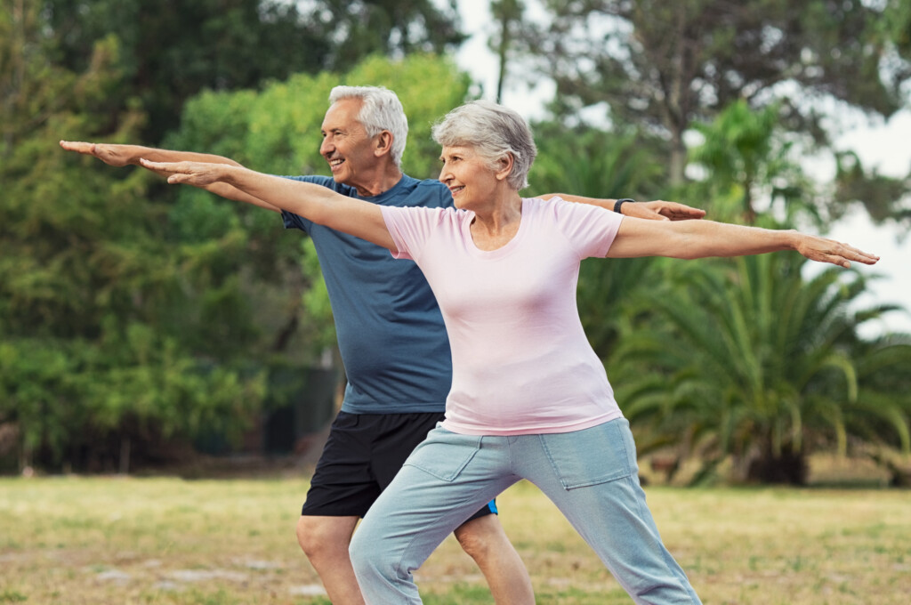
Healthy Aging
“The process of developing and maintaining the functional ability that enables wellbeing in older age."
- World Health Organisation (WHO)
Notes:
If we are going to live longer we want to be healthier for longer.
We want quality years with independence and the energy to enjoy life

Slide 8
Notes:
Time does not stand still for anybody, and we are all getting older.
There is absolutely nothing we can do about our chronological age. It’s there on our birth certs for evermore.
Our biological age we can do something about
Biological ageing is how our cells and tissues (bones, muscles, organs etc) are ageing

Slide 9
The research says…

Slide 10
The research says…

Slide 11
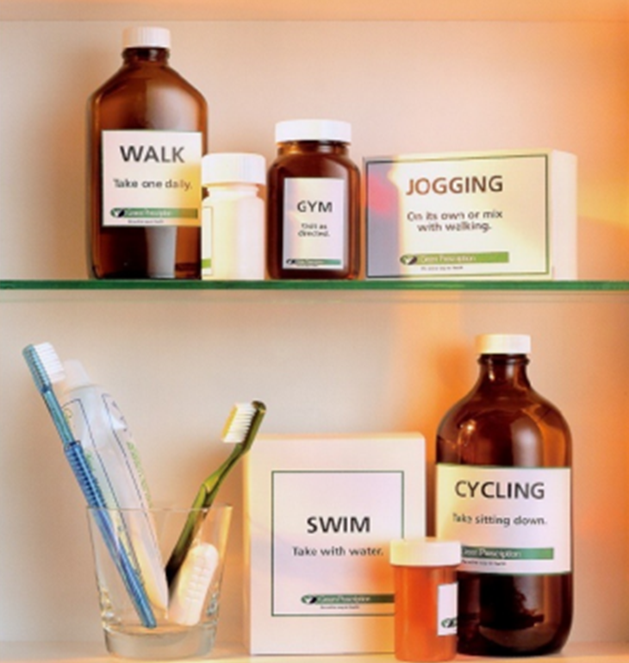
Important to remember that there are different types of exercise.
Each of which have benefits.
1. Movement/activity/ aerobic exercise
2. Strength
3. Balance

Slide 12
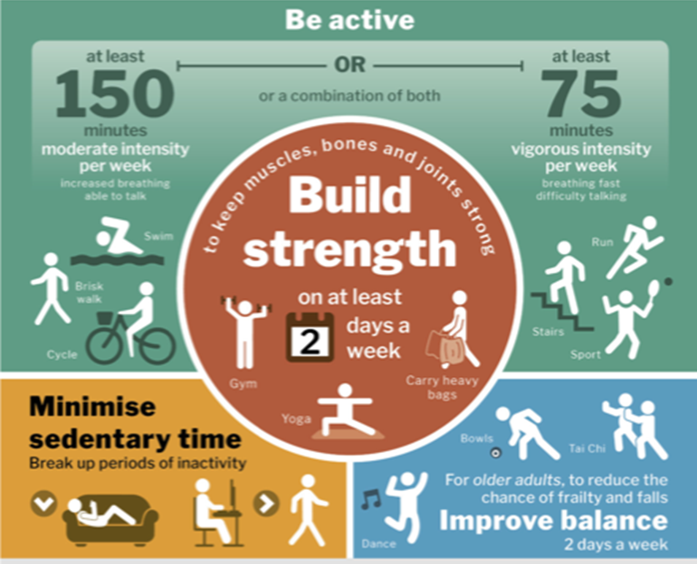
75mins of vigorous intensity
(Breathing fast, difficulty breathing)
OR
150mins of moderate intensity
(Increased breathing, able to talk)
Can be broken up into 10mins blocks
**Exercise to improve strength and balance = 2 days per week

Slide 13
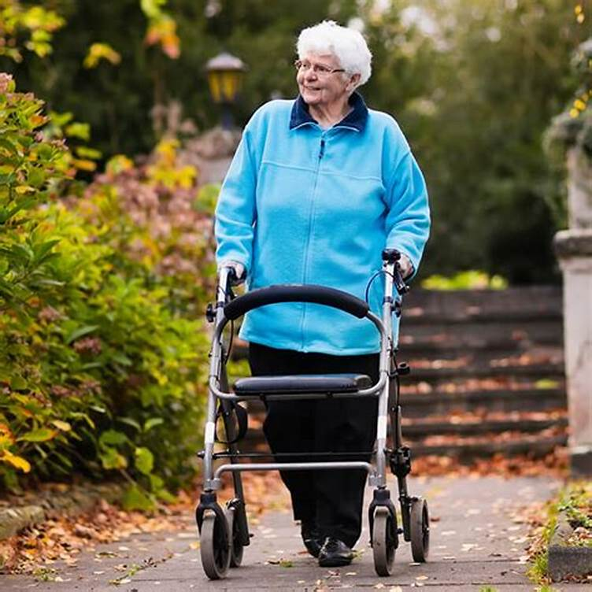
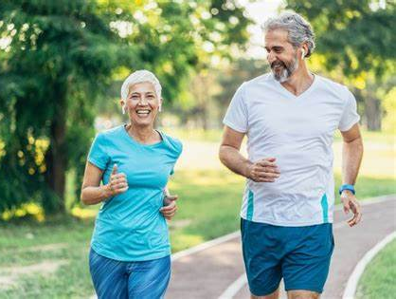
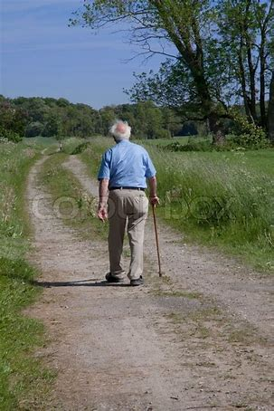
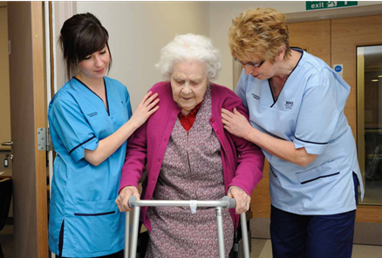
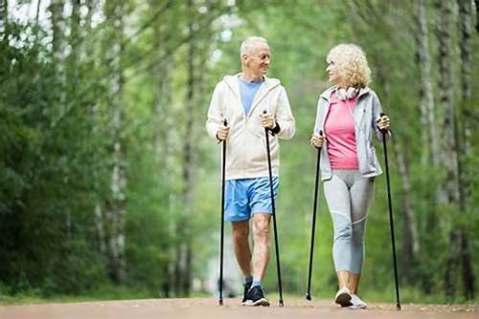
Just keep moving!

Slide 14
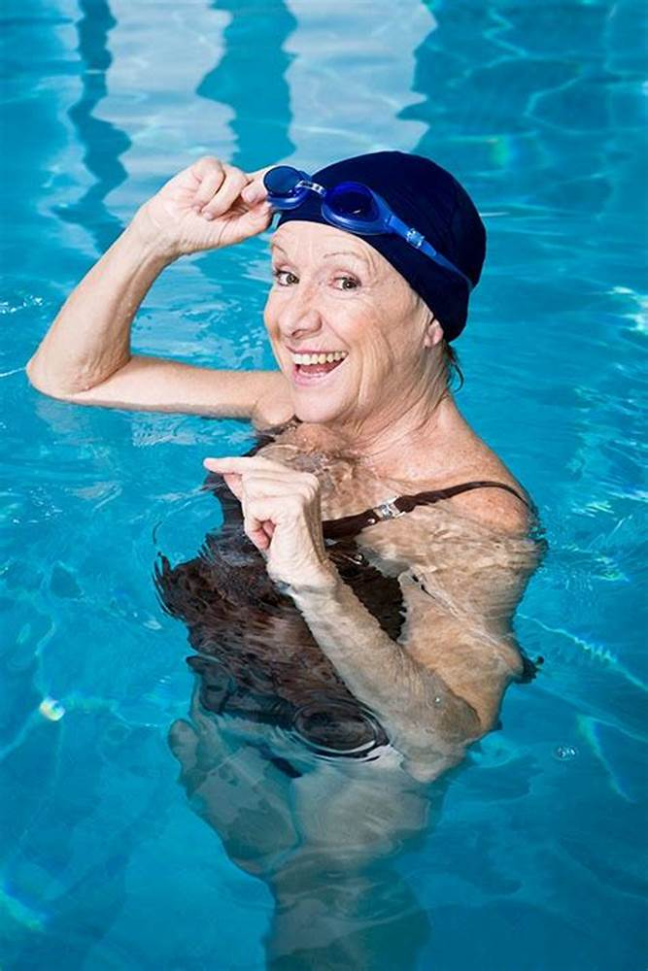
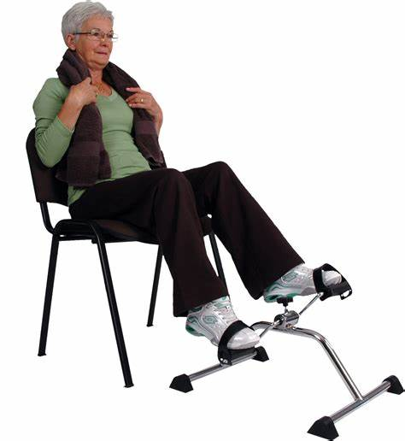
Any other options?

Slide 15
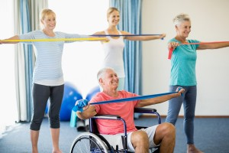
Strength Exercises
*Completed much slower and with resistance i.e a band or weight
Notes:
Different ways to complete strengthening exercises.
These exercises target specific muscles and should be completed slowly

Slide 16
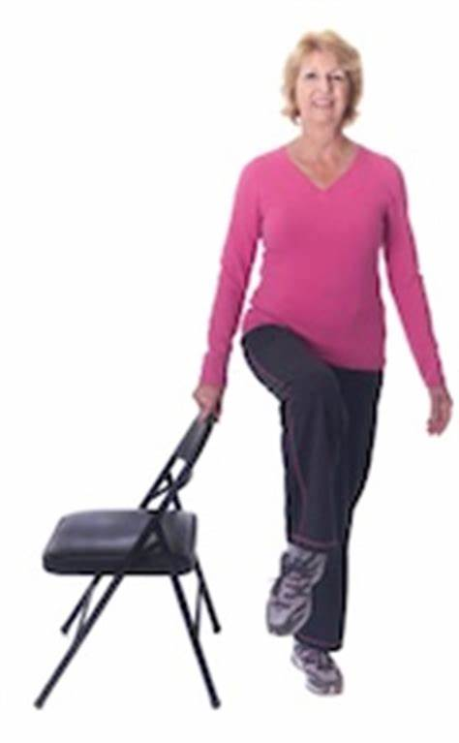
Balance
*Great for preventing falls

Slide 17
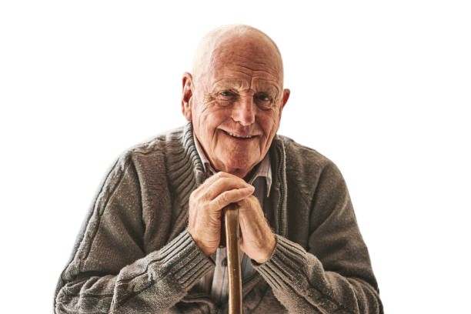
85 Years of age and wants to start weight training?
What do you say?
Notes:
Is it too late to start?

Slide 18
“The idea is to turn the heads of the young 70-year-old girls on the beach"

Slide 19
What are the perceived barriers to strength training?
‘I’m too old to lift weights’
‘I have pain in my joints, exercise will make it worse’
‘I have osteoarthritis. I need a joint replacement.’
‘I’m nervous I will fall if I do exercise.’

Slide 20
Only frail or infirm people fall, don’t they?
Falls are an inevitable part of getting older.
False – 1 in 3 people over 65 fall, most in decent health. The risk of falling increases as we get older.
Not necessarily. The vast majority of falls could be prevented with some modest changes to lifestyle and homes.

Slide 21
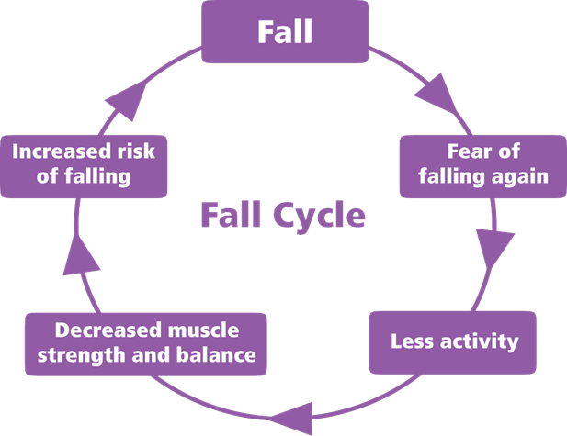

Slide 22
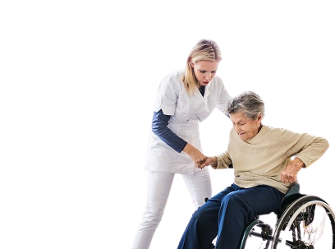
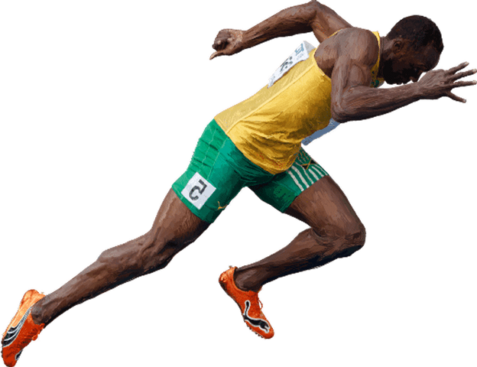
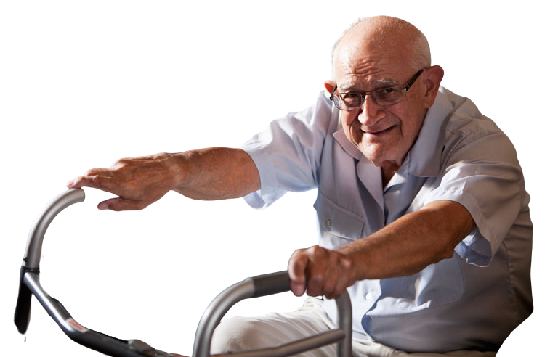
There is a level of exercise for EVERYONE…

Slide 23
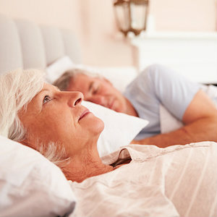
Sleep
*Need between 7-9 hours of sleep
As we get older getting a good night's sleep can become more difficult due to:
Medications
Trips to the bathroom
Feeling uncomfortable in bed
Reduced melatonin
Post menopause
Stress / anxiety
Notes:
Sleep patterns are different for everyone
Medication can have an effect and cause people to feel drowsy and sleepy
Common for older adults to go to bed earlier and wake earlier

Slide 24
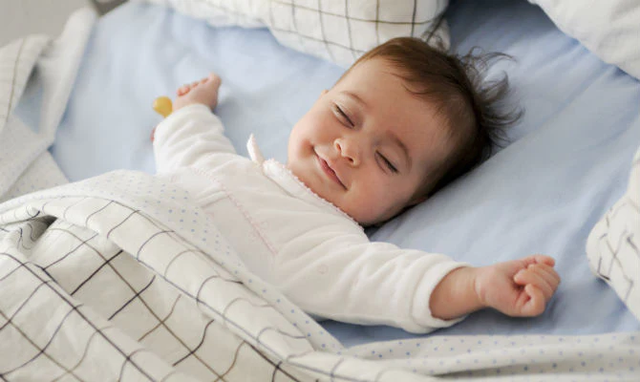
Tips to sleep like a baby:
Avoid caffeine late in the evening
(Tea and coffee)
Regular exercise
Routine
Reduce TV or screen time before bedtime
Daytime naps are good but.. Try to avoid late evening naps
Review medication if needed

Slide 25
Look after your mood
Changes in your mood are normal as you age. Especially post menopause.
Post retirement many people experience mood changes
Try to keep your mind and body active to help your mood
Chat to someone who can help. Start by asking your GP for advice

Slide 26
Take home messages
You can never go wrong getting strong
There is a level of exercise for absolutely EVERYONE!
Start today.. It is never too late!
Do as much as you possibly can.. For as long as you possibly can..

Slide 27
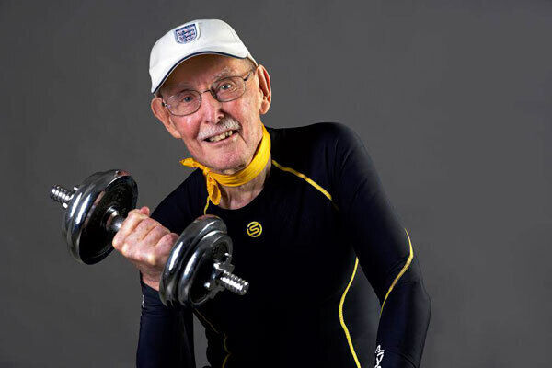
Thank you

